Slide 1
Intro to R for Biologists Session 2 Data exploration
Irina & Rao
07/07/2021
Summer 2021

Slide 2
Intro to R for biologists
Data exploration
Reading and writing data files
Managing working directory
Functions to explore data
Cleaning data
Functions to modify a data.frame
Basic plots to visualize data
Basic statistics
Filtering data

Slide 3

Reading data into R
Base functions:
read.table(file, header = FALSE, sep = "", quote = "\"'", dec = ".", numerals = c("allow.loss", "warn.loss", "no.loss"), row.names, col.names, as.is = !stringsAsFactors, na.strings = "NA", colClasses = NA, nrows = -1, skip = 0, …)
read.csv(file, header = TRUE, sep = ",", quote = "\"", dec = ".", fill = TRUE, comment.char = "", …)
read.delim(file, header = TRUE, sep = "\t", quote = "\"", dec = ".", fill = TRUE, comment.char = "", …)

Slide 4

Reading data into R
xls, xlsx files
install.packages("readxl") - install the package
library(readxl) - load the package
Other package: openxlsx
read_excel(path, sheet = NULL, range = NULL, col_names = TRUE, col_types = NULL, na = "", trim_ws = TRUE, ...)
read_xls(path, sheet = NULL, range = NULL, col_names = TRUE, col_types = NULL, na = "", trim_ws = TRUE, ...)
read_xlsx(path, sheet = NULL, range = NULL, col_names = TRUE, col_types = NULL, na = "", trim_ws = TRUE, ...)
https://www.rdocumentation.org
More examples (over 21 000 packages)

Slide 5
Managing working directory
The working directory is a file path on your computer that sets the default location of any files you read into R, or save out of R.
getwd() - returns the current working directory
setwd("path/to/your_new_wd") - changes the working directory
list.files() - displays the list of all the files in wd
Note: getwd() function has no arguments!

Slide 6

Write files from R
Base functions:
write.table(my_data, file = “my_data.txt”, append = FALSE, sep = " ", dec = ".", row.names = TRUE, col.names = TRUE)
Set separator to sep = “\t” to get tab separated txt file
write.csv(my_data, file = "my_data.csv") - comma-separated csv files

Slide 7

Write files from R
xls, xlsx files
install.packages("xlsx") - install the package
library(xlsx) - load the package
write.xlsx(my_data, file = “result.xlsx”, sheetName = "Sheet1", col.names = TRUE, row.names = TRUE, append = FALSE)

Slide 8

Let’s explore practically

Slide 9
Adding rows or columns to a data.frame
df1
vec1
1
2
3
1
2
3
1
2
3
1
1
1
df1
2
2
2
3
3
3
4
cbind(df1,vec1)
vec1
rbind(df1,vec1)
1
2
3
4
1
2
3

Slide 10
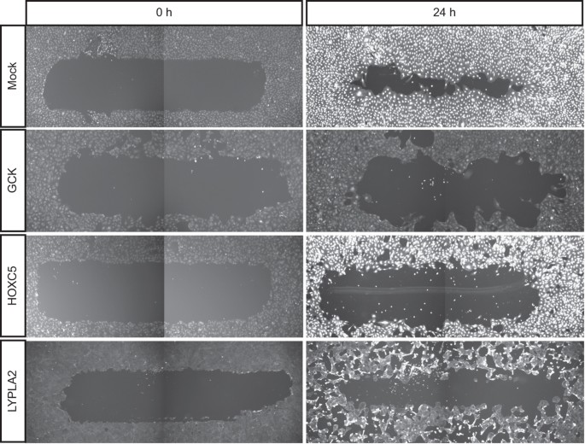

Migration and morphology data
Table 1: Migration data
col1: reagent_id
col2: gene_symbol
col3: migration
Table 2: Morphology data
col1: reagent_id
col2: gene_symbol
col3: elongatedness

Slide 11
Merging data.frames
gene_symbol
elongatedness
reagent_id
gene_symbol
migration
reagent_id
1
2
3
1
2
3
1
1
df1
2
2
df2
3
3
elongatedness
gene_symbol
reagent_id
migration
merge(df1, df2, by = c(“reagent_id”, “gene_symbol”))

Slide 12
Data exploration and cleaning
Look at the data
head(), tail(), class(), str(), View()
Are the data types correct? If not, convert to appropriate type
as.numeric(), as.character(), as.logical()
Is there any missing data? NA or NaN are missing data
na.omit(), complete.cases()
Is there unnecessary data? Rows or columns you don’t need?
Subset the data
Filter the data
Visualise the data with graphs

Slide 13
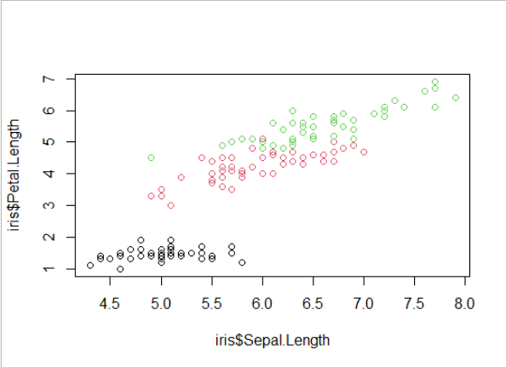
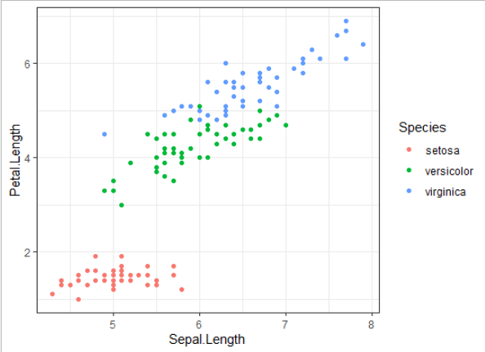
Visualising data
Base R plotting
Great for initial exploration
Quick
Simple syntax – many things can be plotted with just plot()
Not easy to modify colours, aesthetics, etc.
ggplot2 package
Modular – graphs can be built element-by-element
Need to remember a few different functions
Possible to produce publication quality figures with relative ease

Slide 14
Let’s explore practically

Slide 15
Filtering data
Keep/remove data that satisfies one or more conditions
> my_vec = c(1, 2, 3, 4, 5, 6)
> my_vec < 4
TRUE TRUE TRUE FALSE FALSE FALSE
> my_vec[my_vec < 4]
1 2 3
For more than one condition, we need to use logical operators
& (AND)
| (OR)

Slide 16
Logical operators
TRUE & TRUE # evaluates to TRUE
TRUE & FALSE # evaluates to FALSE
FALSE & FALSE # evaluates to FALSE
TRUE | FALSE # evaluates to TRUE
> my_vec = c(1, 2, 3, 4, 5, 6)
> my_vec < 4 & my_vec > 2
FALSE FALSE TRUE FALSE FALSE FALSE
> my_vec[my_vec < 4 & my_vec > 2]
3

Slide 17
Let’s explore practically

Slide 18
Loop functions
lapply() – perform an action on each element of a vector: returns list
sapply() – as above, returns a simplified object (variable)
apply() – loop over rows or columns of a matrix or df
tapply() – loop over a vector, split based on a factor
mapply() – loop over more than one vector
> my_list = list(a = c(1, 2, 3), b = c(4, 5, 6), c = c(7, 8, 9))
> lapply(my_list, mean)
$a
[1] 2
$b
[1] 5
$c
[1] 8

Slide 19
Useful reference
R Programming for Data Science (Roger Peng) – Ch. 3, 4, 5, 9
Swirl – Interactive learning

